Slide 1

Research Progress Record
Enmao Diao
Oct 4, 2020

Slide 2
Overview
Multimodal Controller for Generative Models
Multimodal Controller for Generating Speech, Music and Text
Heterogenous Federated Learning
Subnetworks
Smart Turbulence
Finite Neural Networks
Others
Preliminary Exam
Dissertation

Slide 3
Multimodal Controller for Generative Models
Paper submitted to AAAI
We add experiments of COIL100 dataset since submitted to NeurIPS
We focus more one subnetworks and talk less about data creation
The latest version is mostly finalized

Slide 4
Multimodal Controller for Generative Models
For now MC can only handles class-conditional information. MC cannot handle attribute like CelebA dataset
Propose to generate random codes as before and then multiply CelebA attribute with codes in F_2 so the transformed codes are also in F_2
It is related to our latest research on federated learning. We can allocate unique subnetwork for each class of data. When optimizing a subtask (data of the number of classes smaller than the total number of classes, various subtasks will produce different subnetworks.

Slide 5
Multimodal Controller for generating Speech, Music and Text
Application level work. Need help from undergrad or grad students
Speech and Music
Next year
Speech and Music synthesis
Text-to-Speech synthesis
NLP
NAACL (Nov 24, 2020) or Next year
Text generation

Slide 6
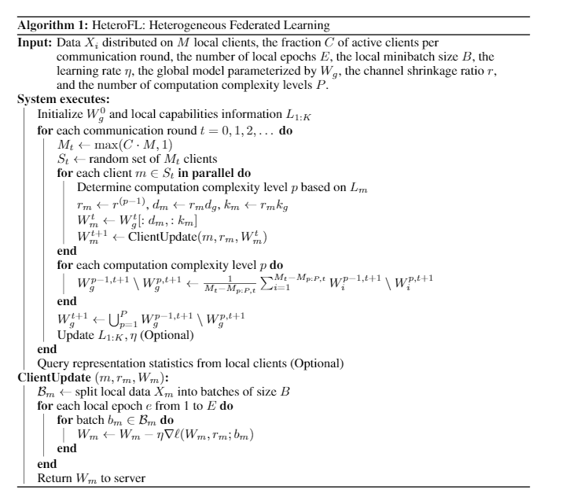
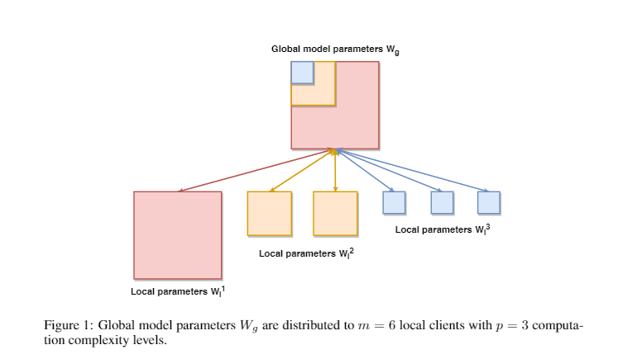
Heterogeneous Federated Learning
Submitted to ICLR
Enable training local models of different model complexity and produce a single global inference model

Slide 7
Heterogeneous Federated Learning
Things to do before Rebuttal
The training of non-IID CIFAR10 seems less stable. We will set the random seed of non-IID data partition
More detailed study on Masked Cross-Entropy Loss with few-shot learning dataset like Omniglot.
The intuition is that in minibatch optimization, batch size is possibly smaller than the number of classes. Thus, we may accidentally optimize losses related classes that are not present in current batch. It is related to the non-IID case of Federated Learning. We find in our work HeteroFL, MCE works. Thus, MCE may be able to facilitate and stabilize the optimization of such dataset in other cases like few shot learning and large-scale classification.

Slide 8
Subnetworks
Use random subnetworks to replace stacking parallel and sequential layers
Example
For deep neural network, instead of stacking layers, each layer now forward the same layer but with a different random mask. Compare this result to no random masking
Transformer use multi-head attention. Each head has a new set of three linear layers to model. Propose to let every head forward the same set of three linear layers but with different masking
Tree LSTM use grammatical structure to learn recurrent model. Propose to let every node in hierarchical structure to mask from a single network
Ultimately, each parameter in every neural network layer can be sampled from a pool of overall parameters. Thus, various layer of networks can share parameters

Slide 9
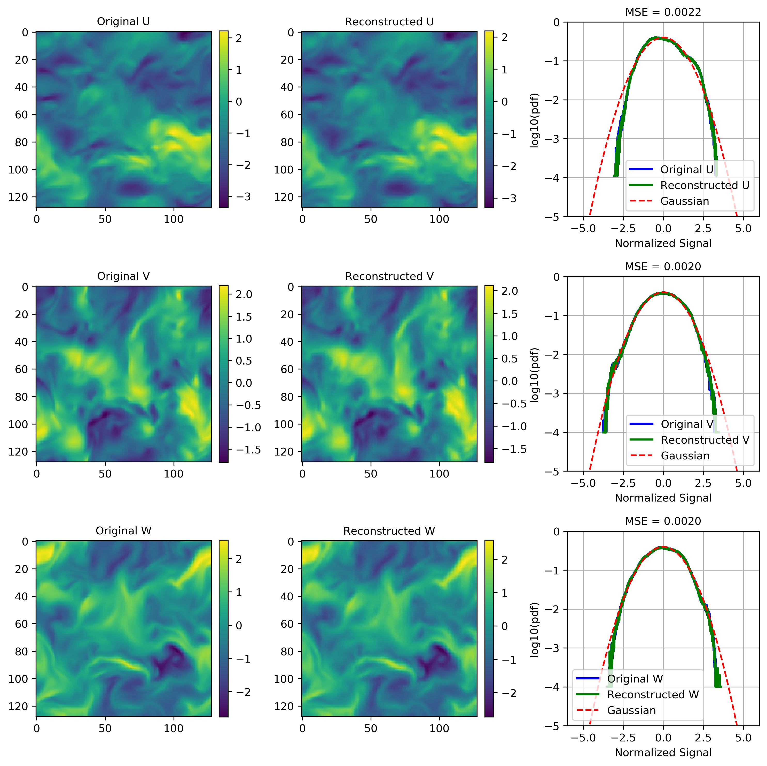
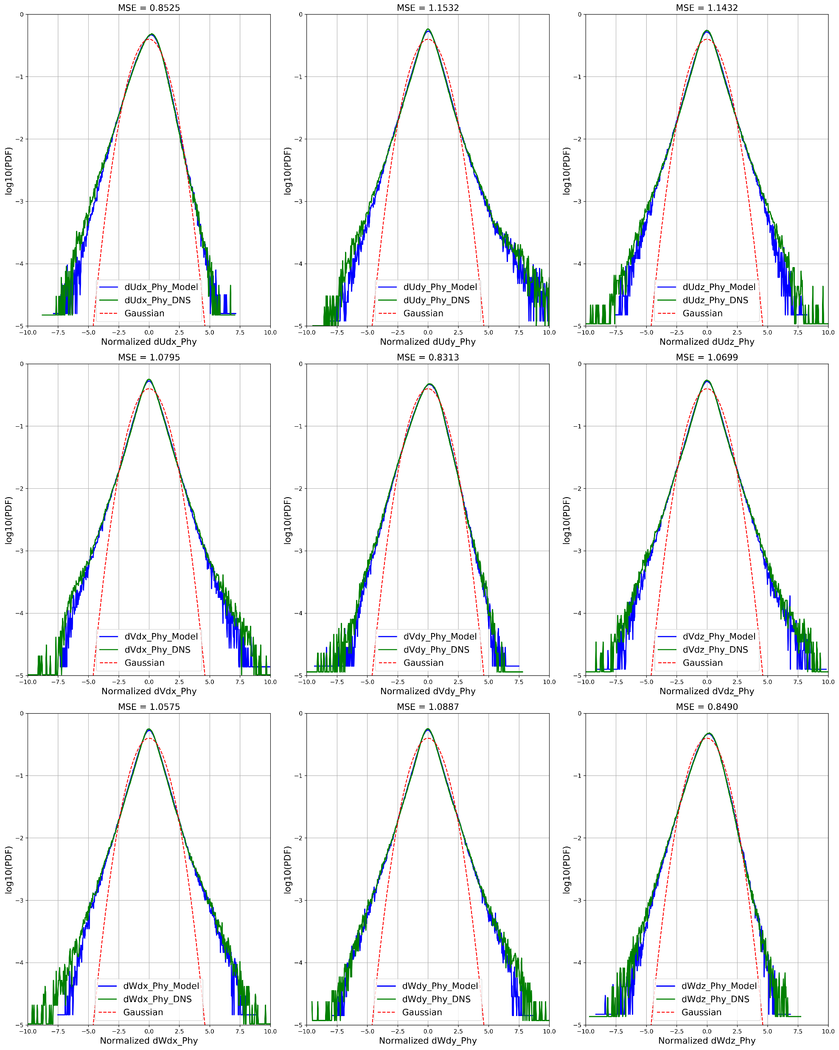
Smart Turbulence
Use VQ-VAE to first reduce 3D data (can be used in music and speech synthesis)
Add gradient constraint during training
Time series prediction on coded space using convolutional Transformer

Slide 10
Finite Neural Networks
Input, weights and output are all on finite field
I find formal derivatives can be defined for finite field with product rule of calculus
In mathematics, the formal derivative is an operation on elements of a polynomial ring or a ring of formal power series that mimics the form of the derivative from calculus.
https://en.wikipedia.org/wiki/Formal_derivative
For example d(X^5)/dx = 5X^4 which means summation of X^4 5 times. d(f(X)/5)/dx = 1/5 d(f(X))/dx in finite field means find a value that when add 5 times equal d(f(X))/dx.
I think it is feasible to implement Finite Neural Networks with these definition.

Slide 11
Others
Deep Channel Coding with Transformer
Erasure channel
Possibly better than RNN
Defend adversarial attacks from intermediate layers
Hypothesis: Even though we only change very little to the input image and easily attack trained neural network. Intermediate layer features should have a very different distribution from the trained dataset. The change of result cannot happen within one layer. It is the deep nature makes classifier fragile
Neural Wavelet Transform
Train the kernel inside wavelet to replace convolution layer to reduce computation and kernel size
Possible extend to other integral transform

Slide 12
Others
Model Recording without knowing training data
We may copy a model by training a generator to efficiently generate query and ask prediction from trained models
The generator is optimized from random noise and then exploit a data space that makes the recording of trained model faster than only using random noise
Predictive gradient descent, meta-learning
Forget about learning rate. Theoretically there always exists a best gradient step at each iteration. We use learning history as our training data and predict the best gradient step. Deep Learning for optimization.

Slide 13
Preliminary Exam
Requirements
1) a written dissertation research proposal
2) an oral presentation and defense of this proposal to an approved five-member faculty committee.
The written dissertation research proposal should consist of a 10-page (maximum) report plus appendices providing additional supporting information as well as an anticipated timeline for completion of all PhD degree requirements.
The oral presentation, approximately 45 minutes with extra time allotted for questions posed by the committee throughout and after the presentation, should reflect the contents of the report.

Slide 14
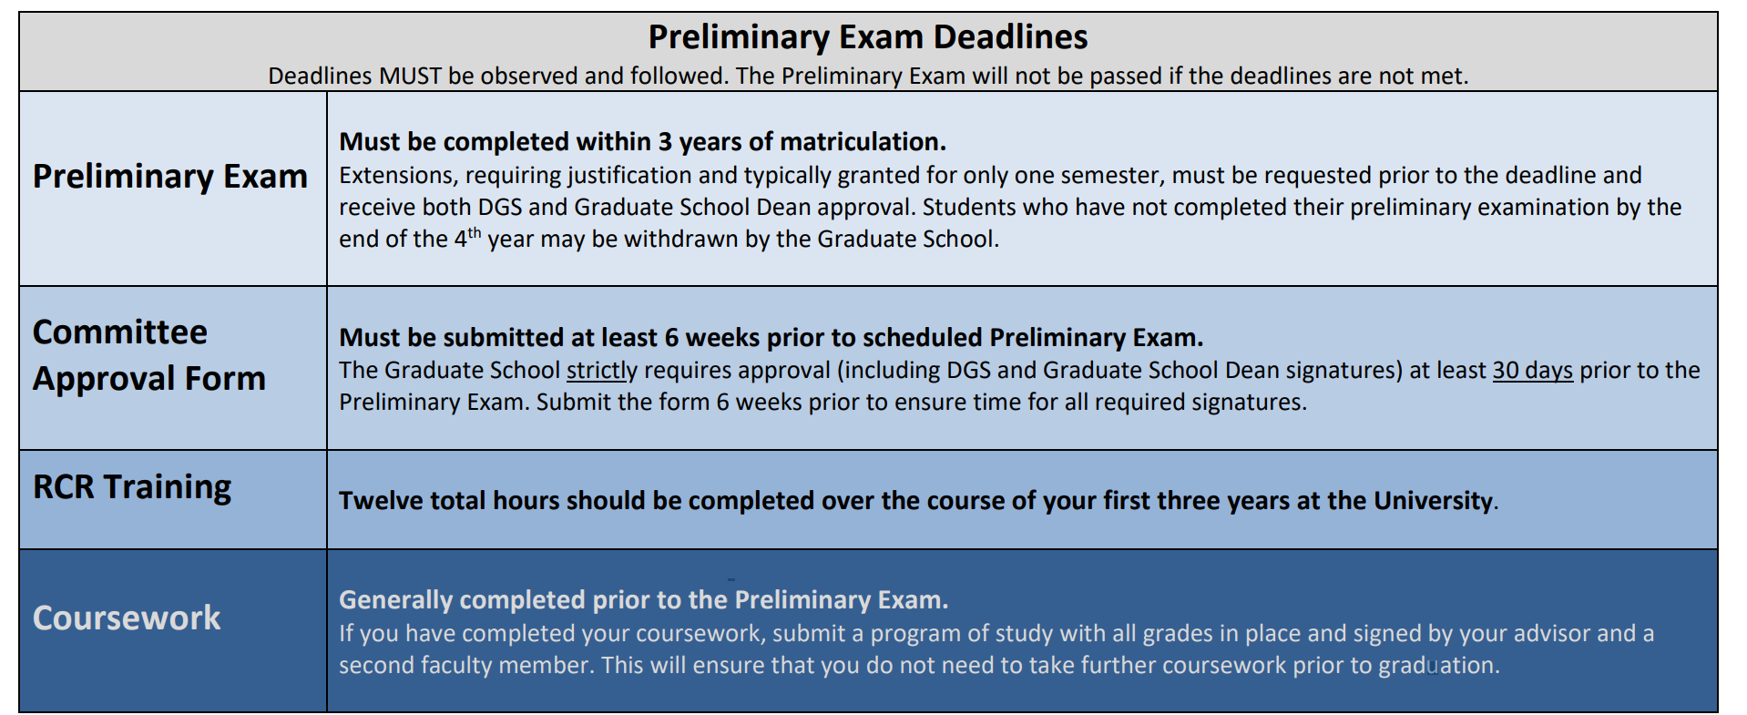
Preliminary Exam
Requirements

Slide 15
Preliminary Exam
Committee
The Graduate School strictly requires approval (including DGS and Graduate School Dean signatures) at least 30 days prior to the Preliminary Exam. Submit the form 6 weeks prior to ensure time for all required signatures.
Five members
Academic advisor
At least one committee member (the Minor Area Representative (MAR)) must be from a department or ECE field outside of the student’s major research area
Potential candidates:
Prof. Lawrence Carin
Prof. Guillermo Sapiro
Prof. Jeffrey Krolik
Prof. Robert Calderbank
Prof. Henry D. Pfister
Prof. Sina Farsiu
Prof. David Carlson
Prof. Yiran Chen
Prof. Helen Li

Slide 16
Preliminary Exam
Exam Details Form
Please enter your exam details at least three weeks prior to your exam here:
https://duke.qualtrics.com/jfe/form/SV_bygP2d2XkuLX1gp
I do not use Prelim Exam as MS Exam to earn MS degree
I have completed RCR training requirements
Which work I should present? Multimodal controller or HeteroFL?

Slide 17
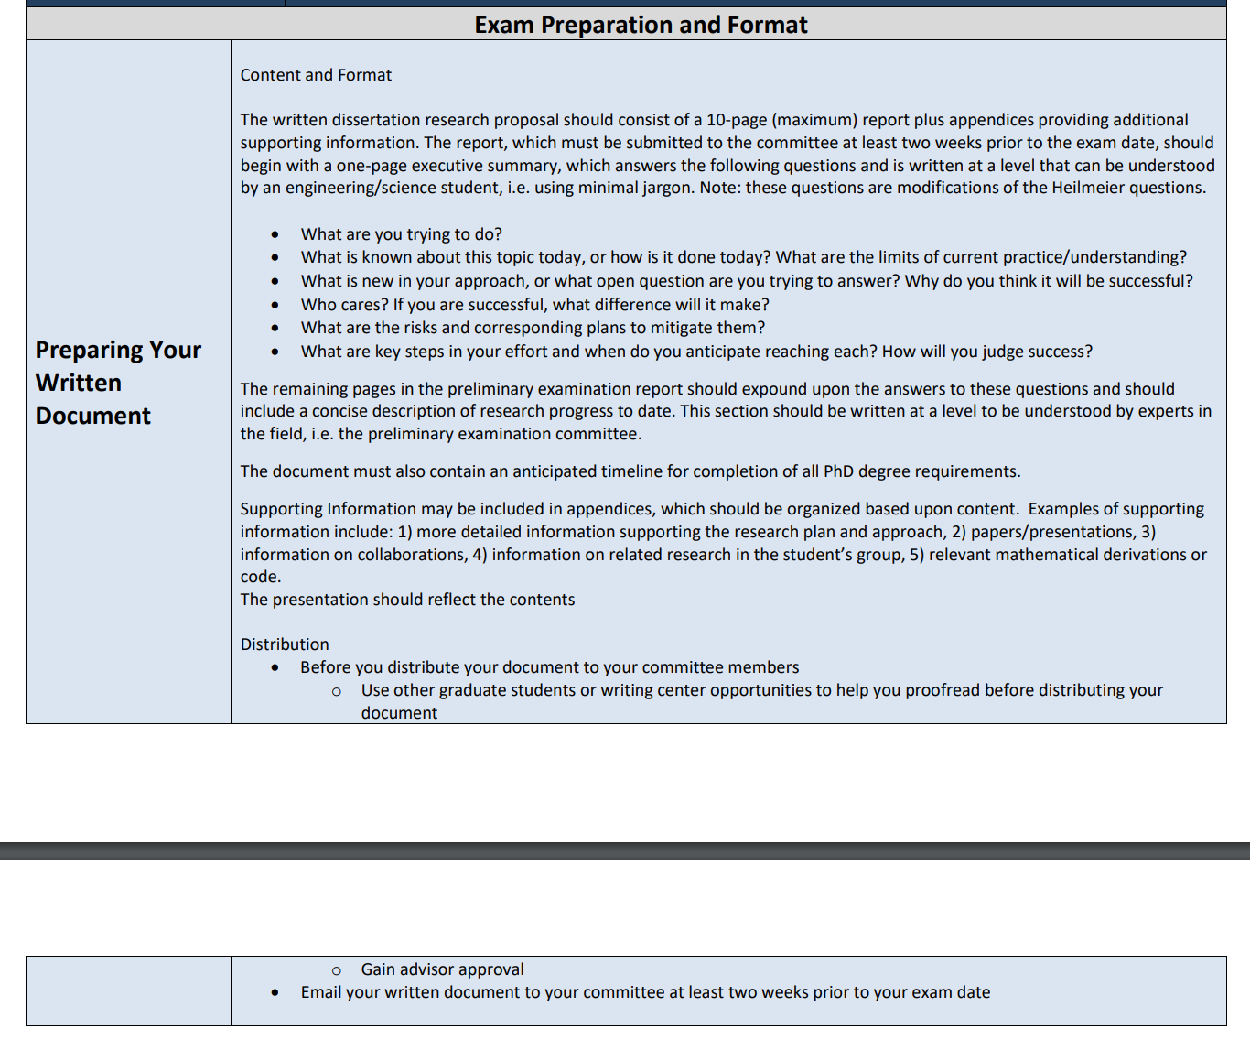
Preliminary Exam
Written Document

Slide 18
Dissertation
I want to study topics related to subnetworks
The key idea of subnetworks is to allocate unique subnetworks for various partition of dataset
DRASIC, Restricted RNN, Multimodal Controller and HeteroFL are all related subnetworks

